Slide 1
Module 4 Attacks and Defenses
Section 5 – Code Vulnerabilities Exploit
June 2018

Slide 2
Code vulnerabilities exploit and mitigation

Slide 3
.
Section 5 – Code Vulnerabilities Exploit
Learning Objectives
Explain attack types based on exploiting code vulnerabilities
What are the methods used for exploit
Mitigation overview
Microsoft defenses (EMET, Reverse and Anti Reverse Engineering, ASLR, DEP, Authenticode, Code Signing, SmartScreen, EAF, SEHOP, CFG)

Slide 4
Code vulnerabilities exploits
Application are developed by programmers and are not error free.
Malware/bootkits/rootkits exploit these vulnerabilities.
Methods used rely on Buffer Overflow, Stack Overflow, SEH exploit, DDoS, Heap Spray, ROP…
Let’s see methods before to enter in countermeasures.

Slide 5
Buffer Overflow Overview
A buffer overflow occurs when:
An attacker is able to enter more data into a buffer than has been allocated by the program, leading areas of memory nearby to be overwritten.
If an attacker can overwrite the CPU’s program counter (also known as Extended Instruction Pointer (EIP) on x86 computers) when the function’s epilogue is called, he or she can potentially execute code of his or her choosing rather than return to the calling function.
This vulnerability is caused by a lack of sufficient bounds checking by the programmer when using certain functions in C/C++ languages.
Notes:
More information around Buffer Overflow attacks:
https://www.redscan.com/news/windows-buffer-overflow-attacks-pt-1/
http://www.cse.scu.edu/~tschwarz/coen152_05/Lectures/BufferOverflow.html

Slide 6
Heap Spray Overview
Heap Spraying
Used by attackers to place shellcode at various locations in the heap
Bad if DEP can be disabled/bypassed
The Heap Spray mitigation pre-allocates some known heap spray targets
Only breaks some heap spray attacks which were known at EMET release
Does not protect against future heap spray targets
Controlled as a per application mitigation

Slide 7
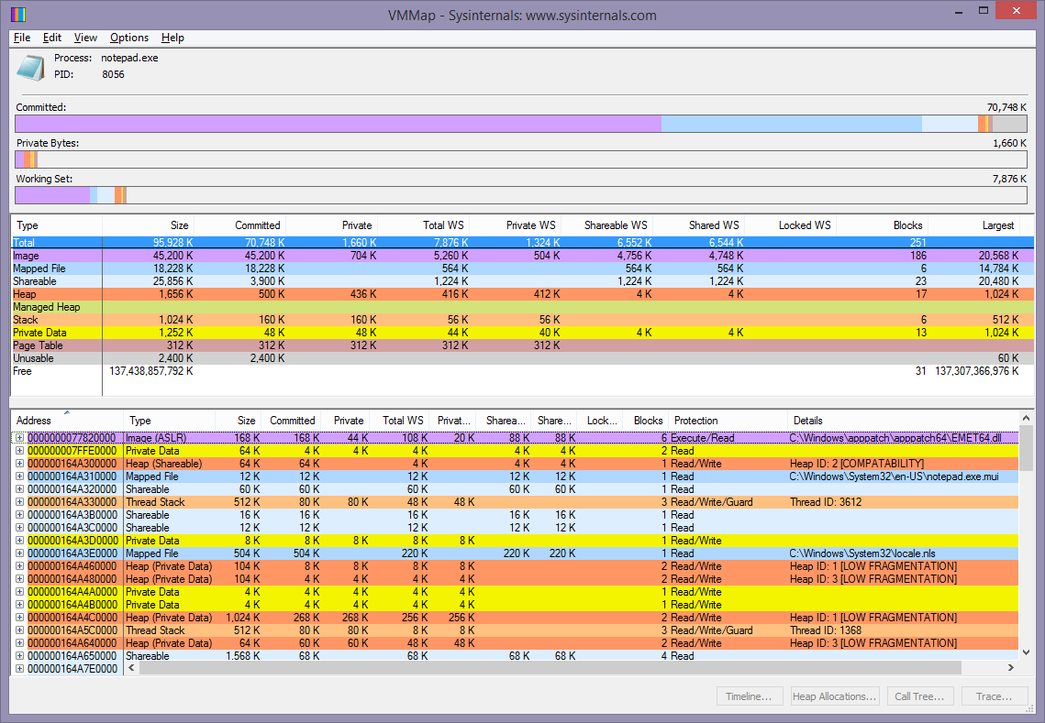
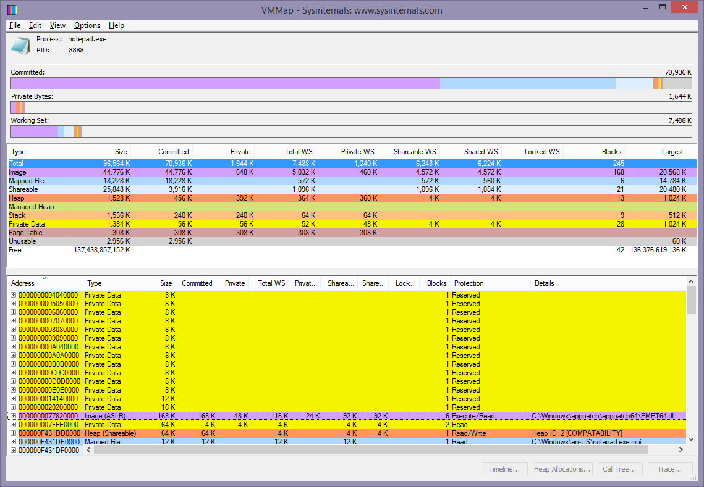
Heap Spray Overview
Heap Spray not enabled
Heap Spray enabled
Notes:
Several notable memory allocations have been made in this second image where Heap Spray has been enabled

Slide 8
Null Page Allocation Overview
Like heap spray:
Allocates the first page in the process virtual address space
Prevents potential null dereference issues in user mode
There is no known way to exploit null dereference
Controlled as a per-application mitigation
Notes:
More information:
https://securityintelligence.com/exploitation-vulnerabilities-allow-diverting-kernel-execution-flow-windows/

Slide 9
SEH overwrites - Overview
Structured Exception Handling(SEH) is the basis of exception handling in Windows
SEH uses a linked-list of nested exception handlers
Attackers use a SEH Overwrite to divert control of code execution
Buffer overflow can be used to overwrite exception pointer in the linked-list
Mitigation can use SEHOP (Structured Exception Handling Overwrite Protection)
Notes:
More reading
https://blogs.technet.microsoft.com/srd/2009/02/02/preventing-the-exploitation-of-structured-exception-handler-seh-overwrites-with-sehop/
Wikipedia: Exception handler - http://en.wikipedia.org/wiki/Exception_handler
Wikipedia: Linked List - http://en.wikipedia.org/wiki/Linked_list
A crass course on the Depths of Win32™ Structured Exception Handling- http://www.microsoft.com/msj/0197/Exception/Exception.aspx

Slide 10
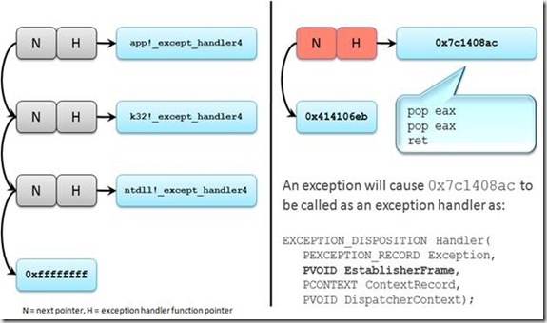
SEH overwrites - Overview
This illustration represents what an SEH overwrite would typically look like from an exploitation perspective:
Notes:
More reading
https://blogs.technet.microsoft.com/srd/2009/02/02/preventing-the-exploitation-of-structured-exception-handler-seh-overwrites-with-sehop/
Wikipedia: Exception handler - http://en.wikipedia.org/wiki/Exception_handler
Wikipedia: Linked List - http://en.wikipedia.org/wiki/Linked_list
A crass course on the Depths of Win32™ Structured Exception Handling- http://www.microsoft.com/msj/0197/Exception/Exception.aspx

Slide 11
Distributed Denial-of-Service (DDoS) Overview
DDoS attacks depend on getting the DDoS client to run on a wide range of machines.
Rely on malicious program like trojan horse, worm or botnet
More details for Gamarue/Andromeda example:
https://www.microsoft.com/en-us/wdsi/threats/malware-encyclopedia-description?Name=Win32/Gamarue
https://cloudblogs.microsoft.com/microsoftsecure/2017/12/04/microsoft-teams-up-with-law-enforcement-and-other-partners-to-disrupt-gamarue-andromeda/?source=mmpc
Notes:
https://msdn.microsoft.com/en-us/library/cc722931.aspx
https://msdn.microsoft.com/en-us/library/cc750213.aspx

Slide 12
Return Oriented Programming (ROP) - Overview
What is ROP?
Exploit technique which overcomes DEP
Reuses existing “known-good” code snippets or “gadgets”
No need for code injection
Takes control of code execution by manipulating the stack
Notes:
More reading
Wikipedia: Call stack - http://en.wikipedia.org/wiki/Call_stack
Wikipedia: x86 Calling Conventions - http://en.wikipedia.org/wiki/X86_calling_conventions
A gentle introduction to return oriented programming - http://blog.zynamics.com/2010/03/12/a-gentle-introduction-to-return-oriented-programming/
Defeating DEP and ASLR in Windows - http://packetstorm.igor.onlinedirect.bg/papers/bypass/defeating_data_execution_prevention_and_aslr_in_windows_xp_sp3.pdf

Slide 13


Return Oriented Programming (ROP) - Overview
ESP (Stack Pointer)
Call stack example:
Parameters passed from caller to callee
Instruction Pointer is saved as caller return address
Callee completes execution with ret
Caller then resumes execution as Instruction Pointer is set back to saved return address
Locals/Registers
Function B Stack Frame
Caller return address
Parameters to function B
Locals/Registers
Function A Stack Frame
Caller return address
Parameters to function A
Notes:
More reading
Wikipedia: Call stack - http://en.wikipedia.org/wiki/Call_stack
Wikipedia: x86 Calling Conventions - http://en.wikipedia.org/wiki/X86_calling_conventions

Slide 14
Return Oriented Programming (ROP) - Overview
How is ROP achieved?
Starts with stack overflow
Good stack elements are overwritten with return addresses of ROP gadgets
Gadgets end with ret transferring control to next gadget
ESP (Stack Pointer)
Locals/Registers
Function B Stack Frame
GadgetA Address
GadgetB Address
GadgetC Address
Function A Stack Frame
GadgetD Address
...
Notes:
More reading
Wikipedia: Call stack - http://en.wikipedia.org/wiki/Call_stack
Wikipedia: x86 Calling Conventions - http://en.wikipedia.org/wiki/X86_calling_conventions

Slide 15
Return Oriented Programming (ROP) - Load Library Checks
Load Library Checks
ROP chains may be used to load shellcode from remote compromised locations
Load Library Checks hooks LoadLibrary function and validates the library load
Validates that parameter is not a UNC path (E.g. \\server\share\badmodule.dll)
Per-application EMET mitigation setting
Notes:
More reading
Wikipedia: Call stack - http://en.wikipedia.org/wiki/Call_stack
Wikipedia: x86 Calling Conventions - http://en.wikipedia.org/wiki/X86_calling_conventions
A gentle introduction to return oriented programming - http://blog.zynamics.com/2010/03/12/a-gentle-introduction-to-return-oriented-programming/
Defeating DEP and ASLR in Windows - http://packetstorm.igor.onlinedirect.bg/papers/bypass/defeating_data_execution_prevention_and_aslr_in_windows_xp_sp3.pdf

Slide 16
Return Oriented Programming (ROP) - Memory Protection Checks
Memory Protection Checks
The VirtualProtect() function could be used to bypass DEP by changing memory protection flag
Could mark pages with PAGE_EXECUTE_READWRITE and execute stack overflow
MemProt mitigation checks VirtualProtect() is not changing execution policy of stack area
Per-application EMET mitigation setting
Notes:
More reading
Wikipedia: Call stack - http://en.wikipedia.org/wiki/Call_stack
Wikipedia: x86 Calling Conventions - http://en.wikipedia.org/wiki/X86_calling_conventions
A gentle introduction to return oriented programming - http://blog.zynamics.com/2010/03/12/a-gentle-introduction-to-return-oriented-programming/
Defeating DEP and ASLR in Windows - http://packetstorm.igor.onlinedirect.bg/papers/bypass/defeating_data_execution_prevention_and_aslr_in_windows_xp_sp3.pdf

Slide 17
Return Oriented Programming (ROP) - Caller Checks
Caller Checks
Generally a subroutine is entered with a call instruction, storing a return pointer on the stack for resumption of caller code
ret instruction transfers execution back to return point location
Certain critical functions are protected by Caller Checks mitigation:
Validates that function was entered by a call and not a ret
Per-application EMET mitigation setting
Notes:
More reading
Wikipedia: Call stack - http://en.wikipedia.org/wiki/Call_stack
Wikipedia: x86 Calling Conventions - http://en.wikipedia.org/wiki/X86_calling_conventions
A gentle introduction to return oriented programming - http://blog.zynamics.com/2010/03/12/a-gentle-introduction-to-return-oriented-programming/
Defeating DEP and ASLR in Windows - http://packetstorm.igor.onlinedirect.bg/papers/bypass/defeating_data_execution_prevention_and_aslr_in_windows_xp_sp3.pdf

Slide 18
Return Oriented Programming (ROP) - Simulate Execution Flow
Simulate Execution Flow
Simulates the forward execution of code (15 instructions by default)
Validates that the return pointers on the stack point to addresses which follow call instructions
Aims prevent chaining of ROP gadgets
Per-application EMET mitigation setting
Notes:
More reading
Wikipedia: Call stack - http://en.wikipedia.org/wiki/Call_stack
Wikipedia: x86 Calling Conventions - http://en.wikipedia.org/wiki/X86_calling_conventions
A gentle introduction to return oriented programming - http://blog.zynamics.com/2010/03/12/a-gentle-introduction-to-return-oriented-programming/
Defeating DEP and ASLR in Windows - http://packetstorm.igor.onlinedirect.bg/papers/bypass/defeating_data_execution_prevention_and_aslr_in_windows_xp_sp3.pdf

Slide 19
Return Oriented Programming (ROP) - Stack Pivot
Stack Pivot
On entering critical functions detects if stack has been “pivoted”
Determines that the stack pointer references a valid region
Per-application EMET mitigation setting
Notes:
More reading
Wikipedia: Call stack - http://en.wikipedia.org/wiki/Call_stack
Wikipedia: x86 Calling Conventions - http://en.wikipedia.org/wiki/X86_calling_conventions
A gentle introduction to return oriented programming - http://blog.zynamics.com/2010/03/12/a-gentle-introduction-to-return-oriented-programming/
Defeating DEP and ASLR in Windows - http://packetstorm.igor.onlinedirect.bg/papers/bypass/defeating_data_execution_prevention_and_aslr_in_windows_xp_sp3.pdf

Slide 20
Code vulnerabilities exploit and mitigation
We will rely on applications to mitigate these threats, like EMET
We can also identify using anti-reverse and reverse engineering
Some built-in mechanism are available like ASLR, DEP, Authenticode or Code Signing, SmartScreen, EAF, etc.

Slide 21
Mitigation overview

Slide 22
Exploit Protection Mitigations – Part 1
Mitigation | Objective | Can be applied to
Control flow guard (CFG) | Ensures control flow integrity for indirect calls. Can optionally suppress exports and use strict CFG. | System and app-level
Data Execution Prevention (DEP) | Prevents code from being run from data-only memory pages such as the heap and stacks. Only configurable for 32-bit (x86) apps, permanently enabled for all other architectures. Can optionally enable ATL thunk emulation. | System and app-level
Force randomization for images (Mandatory ASLR) | Forcibly relocates images not compiled with /DYNAMICBASE. Can optionally fail loading images that don't have relocation information. | System and app-level
Randomize memory allocations (Bottom-Up ASLR) | Randomizes locations for virtual memory allocations including those for system structures heaps, stacks, TEBs, and PEBs. Can optionally use a wider randomization variance for 64-bit processes. | System and app-level
Validate exception chains (SEHOP) | Ensures the integrity of an exception chain during exception dispatch. Only configurable for 32-bit (x86) applications. | System and app-level
Validate heap integrity | Terminates a process when heap corruption is detected. | System and app-level
Notes:
https://docs.microsoft.com/en-us/windows/security/threat-protection/windows-defender-exploit-guard/customize-exploit-protection

Slide 23
Exploit Protection Mitigations – Part 2
Mitigation | Objective | Can be applied to
Arbitrary code guard (ACG) | Prevents the introduction of non-image-backed executable code and prevents code pages from being modified. Can optionally allow thread opt-out and allow remote downgrade (configurable only with PowerShell). | App-level only
Block low integrity images | Prevents the loading of images marked with Low Integrity. | App-level only
Block remote images | Prevents loading of images from remote devices. | App-level only
Block untrusted fonts | Prevents loading any GDI-based fonts not installed in the system fonts directory, notably fonts from the web. | App-level only
Code integrity guard | Restricts loading of images signed by Microsoft, WQL, and higher. Can optionally allow Microsoft Store signed images. | App-level only
Disable extension points | Disables various extensibility mechanisms that allow DLL injection into all processes, such as AppInit DLLs, window hooks, and Winsock service providers. | App-level only

Slide 24
Exploit Protection Mitigations – Part 3
Mitigation | Objective | Can be applied to
Disable Win32k system calls | Prevents an app from using the Win32k system call table. | App-level only
Do not allow child processes | Prevents an app from creating child processes. | App-level only
Export address filtering (EAF) | Detects dangerous operations being resolved by malicious code. Can optionally validate access by modules commonly used by exploits. | App-level only
Import address filtering (IAF) | Detects dangerous operations being resolved by malicious code. | App-level only
Simulate execution (SimExec) | Ensures that calls to sensitive APIs return to legitimate callers. Only configurable for 32-bit (x86) applications. Not compatible with ACG | App-level only
Validate API invocation (CallerCheck) | Ensures that sensitive APIs are invoked by legitimate callers. Only configurable for 32-bit (x86) applications. Not compatible with ACG | App-level only

Slide 25
Exploit Protection Mitigations – Part 4
Mitigation | Objective | Can be applied to
Validate handle usage | Causes an exception to be raised on any invalid handle references. | App-level only
Validate image dependency integrity | Enforces code signing for Windows image dependency loading. | App-level only
Validate stack integrity (StackPivot) | Ensures that the stack has not been redirected for sensitive APIs. Not compatible with ACG | App-level only

Slide 26
Exploit and Mitigations
Application are developed by programmers and are not error free. Malware/bootkits/rootkits exploit these vulnerabilities.
We also can rely on applications to mitigate these threats, like EMET
We can also identify the use of anti-reverse and reverse engineering
Some built-in mechanism are also available like ASLR, DEP, Authenticode or Code Signing, SmartScreen

Slide 27
Key concepts EMET

Slide 28
Microsoft Enhanced Mitigation Experience Toolkit (EMET)
Windows add-on that improves the defensive posture of the system it is installed on, by adding operating system-based attack mitigations to applications, that may be vulnerable to known or unknown vulnerabilities.
Microsoft Security Research and Defense group, which released EMET, has a blog with security analysis of Microsoft vulnerabilities and attacks on Microsoft products.
There are no plans to offer support or security patching for EMET after July 31, 2018.

Slide 29
EMET - Mitigations
Feature | Purpose
Structure Exception Handler Overwrite Protection (SEHOP) | SEHOP enabled Windows to verify the execution stack to verify it is unchanged.
Dynamic Data Execution Prevention (DEP) | DEP prevents code in memory from being executed unless it is explicitly flagged as executable.
Heapspray Allocations | Common memory locations are pre-allocated by EMET so attacks that attempt to place attack code in those locations will fail. This mitigation implementation is directly based on existing attacks.
Null page allocation | Another method to protect memory from being exploited by attackers. Microsoft notes that no known attacks of this nature exist, so this is a more proactive mitigation.
Mandatory Address Space Layout Randomization (ASLR) | ASLR randomizes the location of modules and functions so an attacker cannot predict them. EMET forces this feature upon applications that were not compiled to use it, allowing improved hardening of high-risk applications.
Export Address Table Access Filtering (EAF) | EAF makes it more difficult to exploit code to find and take advantage of Windows APIs. This will often stop an exploit from successfully compromising the system.

Slide 30
EMET and OS platform supported
 | EMET 5.2 | EMET 5.5
Windows 10 RTM, Windows 10 version 1511, and Windows 10 version 1607 Under current plans, EMET will not be supported or operable on Windows versions that are released after Windows Server 2016 and Windows 10 version 1703 and will be replaced with Windows Defender Exploit Guard (WDEG). |  | Y
Windows 8.1 | Y | Y
Windows Server 2012 R | Y | Y
Windows Server 2012 | Y | Y
Windows 7 Service Pack 1 | Y | Y
Windows Server 2008 R2 Service Pack 1 | Y | Y
Windows Server 2008 Service Pack 2 | Y | Y
Windows Vista Service Pack 2 | Y | Y
Notes:
https://support.microsoft.com/en-us/help/2458544/the-enhanced-mitigation-experience-toolkit
Notes EMET has not been tested on Windows Server 2016 and Windows 10 1703, and is not officially supported on either of these versions of Windows. Any critical EMET-related issues on these versions of Windows will be considered on a case-by-case basis, and may or may not result in a fix.
Under current plans, EMET will not be supported or operable on Windows versions that are released after Windows Server 2016 and Windows 10 version 1703.
EMET end of support on 31st of July 2018

Slide 31
Microsoft EMET: Limitations
There are some limits and incompatibilities with some applications.
Reference: EMET mitigations guidelines
Useful links: https://support.microsoft.com/kb/2458544
As EMET is near to its end of support life, you have to consider this Customize Exploit protection article

Slide 32
Key concepts Reverse and Anti Reverse Engineering

Slide 33
Anti Reverse - Inline Functions
If there are very detailed function entries and sections, then the job for the reverse engineer just got much easier.
Engineer will know exactly what is happening when a function is called.
With in lining, this doesn't happen, and the engineer is left guessing as to what is actually happening.
Inline function are “debuggable” in assembly only, no symbols used
__forceinline int func1(int p1, int p2, int p3)
{
int num1 = 0;
int num2 = 0;
int num3 = 0;
...
}

Slide 34
Anti Reverse - Breakpoints
Three types of breakpoints available:
Hardware
Memory
INT 3h breakpoints.
Breakpoints:
essential and without them live analysis of a module is mostly impossible.
allow for the stopping of execution of a program at any point where one is placed.
may be used in areas like Windows APIs, and can very easily find where a dialog box is coming from.
probably the most used technique in cracking, the only competition would be a referenced text string search.

Slide 35
Anti Reverse - Interrupt 3 (INT 3h)
INT 3h breakpoints are represented in in the IA-32 instruction set with the opcode CC (0xCC).
This is the most common expression of this type of breakpoint, it can also be expressed as the byte sequence 0xCD 0x03 which can cause some troubles.
Detecting this type of breakpoint is relatively simple, and some source would look like the following sample. However, we should be careful because using this method of scanning can lead to false positives.

Slide 36
Anti Reverse - Sample code to check for int 3
bool CheckBreakpoint(void* pMemory, long Size)
{ unsigned char *pTmp = (unsigned char*)pMemory;
for (long i = 0; i < Size; i++) { if(pTmp[i] == 0xCC) return true; } return false; }
Code can be more obfuscated :
bool CheckBreakpoint(void* pMemory, long Size)
{unsigned char *pTmp = (unsigned char*)pMemory;
unsigned char charval = 0;
for (long i = 0; i < Size; i++)
{ charval = pTmp[i]; if( 0xAA == (charval ^ 0x66) ) return true; } return false; }
Nb: 0xCC xor 0x66 = 0xAA

Slide 37
Anti Reverse - Memory Breakpoints
Memory breakpoints are implemented by a debugger using guard pages, and they act like "a one-shot" alarm for memory page access.
When a page of memory is marked as PAGE_GUARD and is accessed, a STATUS_GUARD_PAGE_VIOLATION exception is raised, which can then be handled by the current program.
The techniques a debugger uses to implement memory breakpoints can be used to discover if program is currently running under a debugger.

Slide 38
Anti Reverse - Check debugger Using PATCHGUARD
Can be done by allocating a dynamic buffer and write a RET to the buffer.
Then mark the page as a guard page and push a potential return address onto the stack.
When jumping to the allocated page if you are under a debugger (like OllyDBG or windbg) you will hit the RET instruction and return to the address pushed onto the stack before we jumped to our page.
If not a STATUS_GUARD_PAGE_VIOLATION exception occurs, it implies we're not being debugged .

Slide 39
Anti Reverse - Memory Breakpoint Sample
GetSystemInfo(&sysinfo); // Allocate memory
pAllocation = VirtualAlloc(NULL, sysinfo.dwPageSize,
MEM_COMMIT | MEM_RESERVE, PAGE_EXECUTE_READWRITE);
pMem = (unsigned char*)pAlloc; *pMem = 0xc3; // Write a ret to the buffer (0xc3)
VirtualProtect(pAlloc, sysinfo.dwPageSize, PAGE_EXECUTE_READWRITE | PAGE_GUARD, &OldProtect) ; // Set as guard page
__try { __asm
{ mov eax, pAlloc
push MemBpBeingDebugged // return address if under debugger
jmp eax
}
}
__except(EXCEPTION_EXECUTE_HANDLER)
{ // The exception occured no debugger was detected
VirtualFree(pAlloc, NULL, MEM_RELEASE); return false;
}
__asm{MemBpBeingDebugged:} VirtualFree(pAlloc, NULL, MEM_RELEASE); return true;

Slide 40
Anti Reverse - "Ice" Breakpoint
The "Ice breakpoint" is one of Intel's undocumented instruction, opcode 0xF1.
It is used to detect tracing programs.
Executing this instruction will generate a SINGLE_STEP exception. (0x80000004)
If program is already traced, the debugger will believe it is the normal exception generated by executing the instruction with SingleStep bit set in the Flags registers.
The associated exception handler won't be executed, and execution will not continue as expected.
Bypassing this trick is easy: you can run over the instruction, instead and single-stepping on it.
The exception will be generated, but since the program is not traced, the debugger should understand that it has to pass control to the exception handler.

Slide 41
Anti Reverse - Method used to check debugging
kd> !peb
PEB at 000007fffffdf000
InheritedAddressSpace: No
ReadImageFileExecOptions: No
BeingDebugged: No
0:000> dt ntdll!_PEB 7efde000
+0x000 InheritedAddressSpace : 0 ''
+0x001 ReadImageFileExecOptions : 0 ''
+0x002 BeingDebugged : 0 ''
BOOL WINAPI IsDebuggerPresent(void);
BOOL WINAPI CheckRemoteDebuggerPresent

Slide 42
Anti Reverse - ProcessDebugFlags
The ProcessDebugFlags (0x1f) is an undocumented class that can be passed to the NtQueryProcessInformation function.
When NtQueryProcessInformation is called with the ProcessDebugFlags class, the function will return the inverse of EPROCESS->NoDebugInherit, which means that a debugger is present.
NTSTATUS WINAPI NtQueryInformationProcess ( _In_ HANDLE ProcessHandle, _In_ PROCESSINFOCLASS ProcessInformationClass, _Out_ PVOID ProcessInformation, _In_ ULONG ProcessInformationLength, _Out_opt_ PULONG ReturnLength );
ProcessInformationClass [in]
ProcessDebugPort (7) A nonzero value indicates that the process is being run under the control of a ring 3 debugger.

Slide 43
Anti Reverse - Debug Object Handle
When a process is debugged, a debug object in kernel mode would be created for that debugging session.
A handle to this object is also created, and can be queried using NtQueryInformationProcess.
The presence of this handle shows that the process is being actively debugged.
NtQueryInformationProcess (GetCurrentProcess(), 0x1e, &hDebugObject, 4, NULL);

Slide 44
Anti Reverse - OutputDebugString
The OutputDebugString technique works by determining if OutputDebugString causes an error.
An error will only occur if there is no active debugger for the process to receive the string; therefore, we can conclude that if there is no error (by calling GetLastError) after calling OutputDebugString, then there is a debugger present.
OutputDebugString(String); if (GetLastError() == 0) return true; else return false;
OutputDebugString can also be displayed using DBGVIEW tool from Sysinternals:
http://technet.microsoft.com/en-us/sysinternals/bb896647.aspx

Slide 45
Anti Reverse - Parent Process
Normally, Windows users start a process from a window created or provided by the Windows Shell or Services.exe
In this situation, the child process's parent process is Explorer.exe. Therefore, we can retrieve the process ID of Explorer.exe and our parent process and compare them. This is, of course, a somewhat risky process since the parent process of your process isn't guaranteed to be Explorer.exe or services.exe
You can also verify that the parent process of your current process is not a well kwon debugger

Slide 46
Anti Reverse - Thread Local Storage
Windows, like all multithreading operating system provides a mechanism to allow programmers to efficiently store state on a per-thread basis.
This capability is typically known as Thread Local Storage it is used to store global variables that need to be instanced on a per-thread basis.
The general design is that all TLS accesses go through a pointer or array that is present in the TEB, which is a system-defined data structure that is already instanced per thread.
http://msdn.microsoft.com/library/windows/desktop/ms686749(v=vs.85).aspx

Slide 47
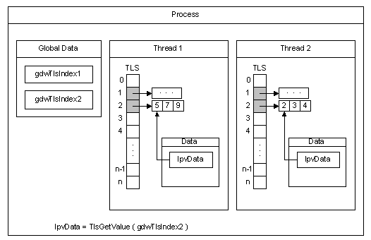
Anti Reverse - Thread Local Storage
The process has two threads, Thread 1 and Thread 2. It allocates two indexes for use with TLS, gdwTlsIndex1 and gdwTlsIndex2.
Each thread allocates two memory blocks (one for each index) in which to store the data, and stores the pointers to these memory blocks in the corresponding TLS slots.
To access the data associated with an index, the thread retrieves the pointer to the memory block from the TLS slot and stores it in the lpvData local variable.

Slide 48
Anti Reverse - Thread Local Storage Anti-Debug
It consists to instruct the PE loader that the first entry point of the program is referenced in a Thread Local Storage entry (10th directory entry number in the PE optional header).
By doing so, the program entry-point won’t be executed first.
The TLS entry can then perform anti-debug checks in a stealthy way.
The Thread Local Storage callback array can be altered at runtime.
Newly added or modified callbacks will be called.
There is no limit to the number of callbacks that can be placed.
Thread Local Storage callback addresses can point outside of the image.
It can be used to defeat DEP (changing memory page flags).
The defense against this technique is easy just insert a breakpoint on the first callback.

Slide 49
Anti Reverse - NtGlobalFlags
When a process is created, the system sets some flags that will define how various APIs will behave for this program. Those flags can be read in the PEB, in the DWORD located at offset 0x68 :
0:000> dt _PEB 000000007ffdf000
ntdll!_PEB
+0x068 ApiSetMap : 0x00000000`00040000 Void
Enable loading of kernel debugger symbols
FLG_ENABLE_KDEBUG_SYMBOL_LOAD
0x040000

Slide 50
Anti Reverse - NtGlobalFlags
GFlags Flag Table
http://msdn.microsoft.com/en-us/Library/ff549596(v=vs.85).aspx
By default, different flags are set depending if the process is created under a debugger or not.
If the process is debugged, some flags controlling the heap manipulation routines in ntdll will be set: FLG_HEAP_ENABLE_TAIL_CHECK, FLG_HEAP_ENABLE_FREE_CHECK and FLG_HEAP_VALIDATE_PARAMETERS.
This anti-debug can be bypassed by resetting the NtGlobalFlags field.

Slide 51
Anti Reverse - PEB (Process Entry Block)
http://msdn.microsoft.com/en-us/library/windows/desktop/aa813706(v=vs.85).aspx
0:000> dt nt!_PEB Ldr Ldr. 7ffdf000
+0x018 Ldr : 0x00007fff`623b03c0 _PEB_LDR_DATA
…
+0x020 InMemoryOrderModuleList : _LIST_ENTRY [ 0x00000000`00312a90 - 0x00000000`00313600 ]
0:000> dt _LDR_DATA_TABLE_ENTRY 00312a90-0x10
ntdll!_LDR_DATA_TABLE_ENTRY
+0x000 InLoadOrderLinks : _LIST_ENTRY [ 0x00000000`003128b0 - 0x00007fff`623b03d0 ]
+0x010 InMemoryOrderLinks : _LIST_ENTRY [ 0x00000000`003128c0 - 0x00007fff`623b03e0 ]
+0x020 InInitializationOrderLinks : _LIST_ENTRY [ 0x00000000`00000000 - 0x00000000`00000000 ]
+0x020 InProgressLinks : _LIST_ENTRY [ 0x00000000`00000000 - 0x00000000`00000000 ]
+0x030 DllBase : 0x00000000`00400000 Void
+0x038 EntryPoint : 0x00000000`0040207e Void
+0x040 SizeOfImage : 0xf000
+0x048 FullDllName : _UNICODE_STRING "C:\dev\loadlibrary\libhost.exe"
+0x058 BaseDllName : _UNICODE_STRING "libhost.exe"

Slide 52
Anti Reverse - CC scanning
A common protection feature used by packers is the CC-scanning loop, aimed at detecting software breakpoints set by a debugger.
If you want to avoid that kind of troubles, you may want to use either hardware breakpoints or a custom type of software breakpoint.
CLI (0xFA) is a good candidate to replace the classic INT3 opcode.
This instruction does have the requirements for the job: it raises a privileged instruction exception if executed by a ring3 program, and occupies only 1 byte of space.

Slide 53
Anti Reverse - Disabling of Debugger
Usage of documented API KdDisableDebugger ;
Example (real rootkit)
kd> kp
Child-SP RetAddr Call Site
fffff880`01f7d828 fffff880`043860b9 nt!KdDisableDebugger(void) fffff880`01f7d830 00000000`00000086 0xfffff880`043860b9
fffff880`01f7d838 ffffffff`8000058c 0x86
fffff880`01f7d840 fffffa80`02499060 0xffffffff`8000058c
fffff880`01f7d848 fffffa80`00698b50 0xfffffa80`02499060
fffff880`01f7d850 00000000`0000000d 0xfffffa80`00698b50
fffff880`01f7d858 fffff800`0186d467 0xd
fffff880`01f7d860 fffff800`0186d865 nt!IopLoadDriver(void * KeyHandle = 0xfffffa80`00931330, unsigned char CheckForSafeBoot = 0x00 '', unsigned char IsFilter = 0x01 '', long * DriverEntryStatus = 0x00000000`00000001)+0xa07

Slide 54
Anti Reverse - Hardware Breakpoints
Hardware breakpoints are a technology implemented by Intel in their processor architecture, and are controlled by the use of special registers known as Dr0-Dr7.
Dr0 through Dr3 are 32 bit registers that hold the address of the breakpoint. Dr4 and 5 are reserved by Intel for debugging the other registers, and Dr6 and 7 are used to control the behavior of the breakpoints (Intel).
Anyone who is interested should read the Intel® 64 and IA-32 Architectures Software Developer's Manual Volume 3B: System Programming Guide .
In order to detect and/or remove hardware breakpoints, two methods can be used:
using Win32 GetThreadContext and SetThreadContext.
using Structured Exception Handling.
The SEH method of manipulating the debug registers is much more commonly seen in anti-reverse engineering programs.

Slide 55
Anti Reverse - using Win32 GetThreadContext
CONTEXT ctx;
ctx.ContextFlags = CONTEXT_DEBUG_REGISTERS;
// Get a handle to our thread
HANDLE hThread = GetCurrentThread();
// Get the registers
if(GetThreadContext(hThread, &ctx) == 0) return -1;
// Now we can check for hardware breakpoints
if(ctx.Dr0 != 0) ++NumBps;
if(ctx.Dr1 != 0) ++NumBps;
if(ctx.Dr2 != 0) ++NumBps;
if(ctx.Dr3 != 0) ++NumBps;
return NumBps;

Slide 56
Anti Reverse - using Structured Exception Handling in ASM
ClrHwBpHandler proto
.safeseh ClrHwBpHandler
ClearHardwareBreakpoints proc
assume fs:nothing
push offset ClrHwBpHandler
push fs:[0]
mov dword ptr fs:[0], esp ; Setup SEH
xor eax, eax
div eax ; Cause an exception
pop dword ptr fs:[0] ; Execution continues here
add esp, 4
ret
ClearHardwareBreakpoints endp
ClrHwBpHandler proc
xor eax, eax
mov ecx, [esp + 0ch] ; This is a CONTEXT structure on the stack
mov dword ptr [ecx + 04h], eax ; Dr0
mov dword ptr [ecx + 08h], eax ; Dr1
mov dword ptr [ecx + 0ch], eax ; Dr2
mov dword ptr [ecx + 10h], eax ; Dr3
mov dword ptr [ecx + 14h], eax ; Dr6
mov dword ptr [ecx + 18h], eax ; Dr7
add dword ptr [ecx + 0b8h], 2 ; We add 2 to EIP to skip the div eax
ret
ClrHwBpHandler endp

Slide 57
Anti Reverse - Thread Hiding
Since Windows 2000 Microsoft introduced a new class to be passed into NtSetInformationThread named HideThreadFromDebugger.
It is the first anti-debugging API implemented by Windows, and is very powerful.
The class prevents debuggers from receiving events from any thread that has NtSetInformationThread with the HideThreadFromDebugger class set.
These events include breakpoints, and the exiting of the program if it is called on the main thread of an application.
NtSetInformationThread (GetCurrentthread(), 0x11, NULL, NULL);

Slide 58
Anti Reverse - UnhandledExceptionFilter
The UnhandledExceptionFilter is the long name for an exception handler that is called when there are no other handlers to handle the exception.
When utilizing the UnhandledExceptionFilter technique, one needs to be aware that if a debugger is attached, that process will exit instead of resuming execution, which in the context of anti-reverse engineering is quite wanted.
See below exception handling schema

Slide 59
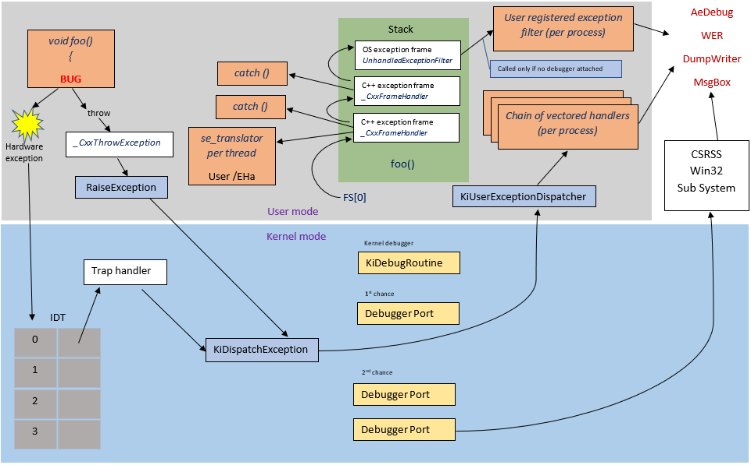
Anti Reverse - Exception Handling Schema

Slide 60
Anti Reverse - Self-Debugging
Self-Debugging is a technique where the main process spawns a child process that debugs the process that created the child.
This technique can be very useful as it can be utilized to implement techniques such as Nanomites and others anti-dumping techniques.
This also prevents other debuggers from attaching to the same process
However, this can be bypassed by setting the EPROCESS->DebugPort (the EPROCESS structure is a struct returned by the kernel mode function PsGetProcessId) field to 0.
It also allows another debugger to attach to a process that already has a debugger attached to it.
Notes:
Nanomites are a powerful anti-dumping technique.

Slide 61
Anti Reverse - Anti-Dumping
"Dumping", a special term used in the reverse engineering world, describes the process of taking an executable that has been protected and after the executable has been decrypted into memory, taking what is essentially a snapshot of the program and saving it onto disk.
You can do it using tools or debuggers :
Windbg
0: kd> .writemem c:\evidence.txt fffffa8025b04000 L0xae0
There are many techniques to prevent the dumping of an executable file that has been encrypted or compressed, and the following slides are some of the more popular or better documented methods.
Notes:
Nanomites are a powerful anti-dumping technique.

Slide 62
Anti Reverse - Anti-Dumping : Nanomites
It works by replacing certain branch instructions, Jcc instructions, within a program with INT 3 breakpoints
Information about the removed jumps is then stored in a heavily encrypted table.
This information includes the destination of the jump, the required CPU flags, and the size of the jump (normally, either two or five bytes).
Then, by using self-debugging, when one of these breakpoints is hit, the debugging process will handle the debug exception, and will look up certain information about the debugging break.
This information is whether or not the breakpoint is a Nanomite or a real debug breakpoint, whether or not the jump should be taken (this includes comparing the EFLAGS registers appropriately for the jump type, i.e.., JNZ needs ZF = 0).
If it is, then the address of the jump is retrieved and the execution in the debuggee will resume from there.
If it is not, then the length of the replaced jump is retrieved, and the size of that specific jump is skipped in the debugger, and execution resumes.
Now, to make things even worse, random INT 3 instructions will be placed at unreachable parts of codes, and entries will be made in the Nanomite table.
There are even entries that do not have a corresponding INT 3 but are placed there to annoy reverse engineers. When used in the correct places inside an executable, this technique is very powerful, and has almost no impact on performance.

Slide 63
Anti Reverse - Anti-Dumping : Stolen Bytes
In the stolen bytes routine, code or bytes from the original process protected by the packer are removed, often from the OEP (Original Entry Point), and are encrypted somewhere inside the packing code.
The area where the bytes are is then replaced with code that will jump to a dynamically allocated buffer that contains the decrypted bytes that were "stolen" from the original code.
This buffer also contains a jump back to the appropriate address of execution.
Very often, both the area were the bytes were removed from and the dynamically allocated buffer where the original bytes reside are filled with junk code and even more anti-reverse engineering techniques.
This can be a powerful technique if the underlying concept is hidden from the reverse engineer.
See more on http://resources.infosecinstitute.com/anti-memory-dumping-techniques

Slide 64
Anti Reverse - Anti-Dumping : SizeOfImage
SizeOfImage is a field in IMAGE_OPTION_HEADER of a PE file, and by increasing the size of this field in the PEB at runtime, we can cause problems for tools that weren't developed to handle this problem.
This method is easily applied to an application, and is easily defeated by reversing applications by enumerating all pages with the MEM_IMAGE flag, starting at the application's ImageBase page.
Assembly code:
__asm { mov eax, fs:[0x30] // PEB
mov eax, [eax + 0x18] // PEB_LDR_DATA
mov eax, [eax + 0x20] // InOrderModuleList
mov dword ptr [eax +0x30], NewSize // SizeOfImage }

Slide 65
Anti Reverse - Anti-Dumping : SizeOfImage in debugger
0:000> !dh 00000000`00400000
File Type: EXECUTABLE IMAGE
FILE HEADER VALUES
14C machine (i386)
3 number of sections
3CD6A31D time date stamp Mon May 06 17:37:01 2002
…
OPTIONAL HEADER VALUES
10B magic #
6.00 linker version
8000 size of code
6000 size of initialized data
0 size of uninitialized data
207E address of entry point
1000 base of code
0000000000400000 image base
…
0.00 image version
4.00 subsystem version
F000 size of image

Slide 66
Anti Reverse - Anti-Dumping : SizeOfImage in debugger
0:000> dt nt!_PEB Ldr Ldr. 7ffdf000
ntdll!_PEB
+0x018 Ldr : 0x00007fff`623b03c0 _PEB_LDR_DATA
…
+0x020 InMemoryOrderModuleList : _LIST_ENTRY [ 0x00000000`00312a90 - 0x00000000`00313600 ]
0:000> dt _LDR_DATA_TABLE_ENTRY 00312a90-0x10
ntdll!_LDR_DATA_TABLE_ENTRY
+0x000 InLoadOrderLinks : _LIST_ENTRY [ 0x00000000`003128b0 - 0x00007fff`623b03d0 ]
+0x010 InMemoryOrderLinks : _LIST_ENTRY [ 0x00000000`003128c0 - 0x00007fff`623b03e0 ]
+0x020 InInitializationOrderLinks : _LIST_ENTRY [ 0x00000000`00000000 - 0x00000000`00000000 ]
+0x020 InProgressLinks : _LIST_ENTRY [ 0x00000000`00000000 - 0x00000000`00000000 ]
+0x030 DllBase : 0x00000000`00400000 Void
+0x038 EntryPoint : 0x00000000`0040207e Void
+0x040 SizeOfImage : 0xf000
+0x048 FullDllName : _UNICODE_STRING "C:\dev\loadlibrary\libhost.exe"
+0x058 BaseDllName : _UNICODE_STRING "libhost.exe"

Slide 67
Anti Reverse - Guard Pages
A guard page provides a one-shot alarm for memory page access. This can be useful for an application that needs to monitor the growth of large dynamic data structures. For example, there are operating systems that use guard pages to implement automatic stack checking.
To create a guard page, set the PAGE_GUARD page protection modifier for the page. This value can be specified, along with other page protection modifiers, in the VirtualAlloc, VirtualAllocEx, VirtualProtect, and VirtualProtectEx functions. The PAGE_GUARD modifier can be used with any other page protection modifiers, except PAGE_NOACCESS.
If a program attempts to access an address within a guard page, the system raises a STATUS_GUARD_PAGE_VIOLATION (0x80000001) exception. The system also clears the PAGE_GUARD modifier, removing the memory page's guard page status. The system will not stop the next attempt to access the memory page with a STATUS_GUARD_PAGE_VIOLATION exception.
http://msdn.microsoft.com/en-us/library/windows/desktop/aa366549(v=vs.85).aspx

Slide 68
Anti Reverse - Guard Pages
Packers and malware can utilize guard pages to implement, what is in essence, an on-demand decryption/decompression system.
When the executable is loaded into memory instead of decompressing/decrypting the entire contents of the file at run-time, the protector will simply mark all pages that were not immediately needed as guard pages.
After that is done, when another section of code or data is needed, an EXCEPTION_GUARD_PAGE (0x80000001) exception will be raised, and the data can be decrypted or decompressed either from file or from encrypted/compressed contents in memory.

Slide 69
Anti Reverse - Guard Pages (Cont)
This technique has been implemented in two ways, one by hooking KiUserUserDispatcher or by using Self-Debugging.
In the case of hooking when an exception is raised, a check is made, from the hook placed on KiUserUserDispatcher, to find where the exception occurred and if the exception occurred in the process space of the protected executable.
If it is the case the contents will be decompressed from the disk into the page where the program is either expecting data or executable code.
Utilizing this technique can significantly reduce loading times and reduce memory usage for an executable file, because only pages that are needed are ever backed by physical memory (RAM), and only the pages that need to be used are decompressed and decrypted.

Slide 70
Anti Reverse - Guard Pages (Cont)
The second method also implements this technique under the name of CopyMemII, and it behaves in a similar fashion with the exception that it requires the use of self-debugging.
Instead of having empty pages and loading the pages from disk, CopyMemII simply decompresses the pages into memory.
This does not decrypt the pages, the code and data are still secure.
Then, when a page that has not been decrypted is accessed, an EXCEPTION_GUARD_PAGE (0x80000001) exception will be raised, and the debugger process will catch the exception and decrypt the page as needed.
There is, however, the weakness of this implementation is that once a page is decrypted, it stays decrypted in memory.
By exploiting this weakness, a reverse engineer could force the process to touch every page needed by the program and leave the entire program decrypted in memory and in perfect shape for a dump
If the protectors were to remember the last accessed page and were to discard or erase the last used page before decrypting the next page, then this technique would be extremely powerful.

Slide 71
Anti Reverse - Removing the Portable Executable (PE) Header
This is a simple anti-dumping technique that removes an executable's portable executable from memory at runtime.
By doing this, a dumped image would be missing important information such as the RVA (Relative Virtual Address) of important tables (Reloc, Import, Export etc..), the entry point, and other information that the Windows loader needs to utilize when loading an image.
One would want to be careful when utilizing this technique, because the Windows API or maybe legitimate external programs may need access to this information which has been removed.
The other advantage is also that most of the tools that rely on the magic number won’t work.
0x10b : PE32 executable
0×107 : ROM image
0x20b : PE32+ (64 bit) executable

Slide 72
Anti Reverse - Removing the Portable Executable Header - in debugger
0:000> !dh 00000000`00400000
File Type: EXECUTABLE IMAGE
FILE HEADER VALUES
14C machine (i386)
3 number of sections
3CD6A31D time date stamp Mon May 06 17:37:01 2002
…
OPTIONAL HEADER VALUES
10B magic #
6.00 linker version
8000 size of code
6000 size of initialized data

Slide 73
Anti Reverse - Removing the Portable Executable Header - C sample
// Get base address of module
char *pBaseAddr = (char*)GetModuleHandle(NULL);
// Change memory protection
VirtualProtect(pBaseAddr, 4096, // Assume x86 page size
PAGE_READWRITE, &PrevProt);
// Erase the header
ZeroMemory(pBaseAddr, 4096);

Slide 74
Anti Reverse - Using Debugger
The following technique can be used to detect if WinDBG is running on the host machine.
FindWindow
HANDLE hWinDbg = FindWindow(TEXT("WinDbgFrameClass"), NULL);
if(hWinDbg)
ExitProcess(0);

Slide 75
Anti Reverse - Using Debugger
Check if unwanted process are running (just like malwares do with AV)
// Take a snapshot of all processes in the system.
hProcessSnap = CreateToolhelp32Snapshot(TH32CS_SNAPPROCESS, 0);
if( Process32First(hProcessSnap , &pe32 ) )
{ do{ if( strcmp( pe32.szExeFile, " Windbg.exe ") == 0 ) { return True; } }while( Process32Next( hSnapshot, &pe32 ) ); } return FALSE;

Slide 76
Anti Reverse - Junk Code
Junk code is a weak technique of code obfuscation.
It just utilizes code that is junk or not needed to confuse a reverse engineer on what the current code is actually trying to accomplish.
When the junk code that is inserted into a routine is convincing and successfully manages to confuse a reverse engineer, then this technique can be rather effective.
These instructions are either placed and utilized carefully or not used at all.
Here is an example of a routine that adds two numbers and subtracts one, but has junk code added in.

Slide 77
Anti Reverse - Native Code Permutations
When we do permutation of an item or object, we're simply trying to represent the same information or actions in a different way.
Now, we'll do the permutation of the simple assembly mov instruction:
Permutation 1:
push 7
pop [mem addr]
Permutation 2:
mov eax, mem addr
mov [eax], 7
Permutation 3:
mov edi, mem addr
mov eax, 7
Stosd
Etc …

Slide 78
Anti Reverse - Native Code Permutations
It can be a very powerful and flexible method of obfuscation and confusion.
Especially considering that a lot of people are simply following tutorials when reversing, and even small changes will completely prevent them from reversing your application.
Then, when this concept is applied to an executable at runtime, and if at every run the program is permutated and morphed, we can achieve metamorphic code.

Slide 79
Anti Reverse - Obfuscation
The general appearance of the source code of an obfuscated application is as bellow :
all ID’s are renamed (refactoring) :
variables, constants, classes, methods, attributes.
Deleting all comments
Unused API declarations removed
Deleting of style rules
Strings encryption to hide their value. The decryption key and decryption function will be embedded in the code.

Slide 80
Anti Reverse - Obfuscation
Changing the order of Boolean expressions
Increase the amount of arguments to methods using fake arguments
Increase the level of nesting of the code by adding unnecessary structures
Increase the complexity of data structures (increase of the number of dimensions of arrays...)
Add complexity to the conditions of loop without changing the number of turns

Slide 81
Anti Reverse - Obfuscation
Code swapping: an piece of code compiled may be replaced by another that must be interpreted by an interpreter provided by the obfuscator, but this technique is costly in resources and is opposed to the dissemination of the software, but provides a high level of protection.
Add redundant operands in arithmetic expressions.
Parallelization of code not to increase performance but to obscure the graph control, static analysis by obfuscators of parallelized tasks is more difficult.
A sequential section of code can be easily parallelized if it contains no data dependency.
For example code can be parallelized with threads, if there are dependencies of data, synchronization can be made.

Slide 82
Anti Reverse - Obfuscation : Base64 encoding
Base64 encoding has been used for a long time its encoding alphabet contains 64 characters, with the equal sign (=) used as a padding character. The alphabet contains the characters A-Z, a-z, 0-9, + and \.
Base64 is commonly used in malware to disguise text strings.
While the encoded output is completely unreadable, base64 encoding is easier to identify than a lot of encoding schemes, usually because of its padding character. There are a lot of tools that can perform base64 encode/decode functions, both online and via downloaded programs.
Because base64 encoding is so easy to overcome, malware authors usually take things a step further and change the order of the base64 alphabet, which breaks standard decoders. This allows for a custom encoding routine that is more difficult to break.
http://blogs.windows.com/itpro/2011/03/04/whats-emet-and-how-can-you-benefit-enhanced-mitigation-experience-toolkit/
UTF-8
aHR0cDovL2Jsb2dzLndpbmRvd3MuY29tL2l0cHJvLzIwMTEvMDMvMDQvd2hhdHMtZW1ldC1hbmQtaG93LWNhbi15b3UtYmVuZWZpdC1lbmhhbmNlZC1taXRpZ2F0aW9uLWV4cGVyaWVuY2UtdG9vbGtpdC8=

Slide 83
Anti Reverse - Obfuscation : ROT13
ROT13 is perhaps the most simple of the three techniques that’s commonly used is ROT13.
ROT is an ASM instruction for “rotate”, hence ROT13 would mean “rotate 13”.
ROT13 uses simple letter substitution to achieve obfuscated output.
Let’s start by encoding the letter ‘a’. Since we’re rotating by thirteen, we count the next thirteen letters of the alphabet until we land at ‘n’. That’s really all there is to it!
ROT13 can also be modified to rotate a different number of characters, like ROT15.

Slide 84
Anti Reverse - Obfuscation : Runtime Packers
In a lot of cases, the entire malware program is obfuscated. This prevents anybody from viewing the malware’s code until it is placed in memory.
This type of obfuscation is achieved using what’s known as a packer program. A packer is piece of software that takes the original malware file and compresses it, thus making all the original code and data unreadable. At runtime, a wrapper program will take the packed program and decompress it in memory, revealing the program’s original code.
Packers have been used for a long time for legitimate purposes, some of which include reducing file sizes and protecting against piracy. They help conceal vital program components and deter novice program crackers.
Fortunately, we aren’t without help when it comes to identifying and unpacking these files. There are many programs available that detect commercial packers, and also advise on how to unpack. Some examples of these file scanners are Exeinfo PE and PEID

Slide 85
Anti Reverse - Conclusion
Knowing anti-debugging and anti-tracing techniques (un)commonly used by malware or protectors is useful knowledge for a reverse-engineer.
A program will always have ways to find it is run in a debugger - the same applies for virtual or emulated environments, but since ring3 debuggers are some of the most common analysis tools used, knowing common tricks, and how to bypass them, will always prove useful.

Slide 86
Key concepts: ASLR

Slide 87
Address Space Layout Randomization (ASLR)
Address Space Layout Randomization (ASLR) loads DLLs into random memory addresses at boot time. This helps mitigate malware that's designed to attack specific memory locations, where specific DLLs are expected to be loaded.

Slide 88
Address Space Layout Randomization (ASLR)
One of the most common techniques:
gain access to a system is to find a vulnerability in a privileged process that is already running,
guess or find a location in memory where important system code and data have been placed, and then overwrite that information with a malicious payload.
Any malware that could write directly to the system memory could simply overwrite it in well-known and predictable locations.
Address Space Layout Randomization (ASLR)
makes that type of attack much more difficult because it randomizes how and where important data is stored in memory.
With ASLR, it is more difficult for malware to find the specific location it needs to attack.

Slide 89
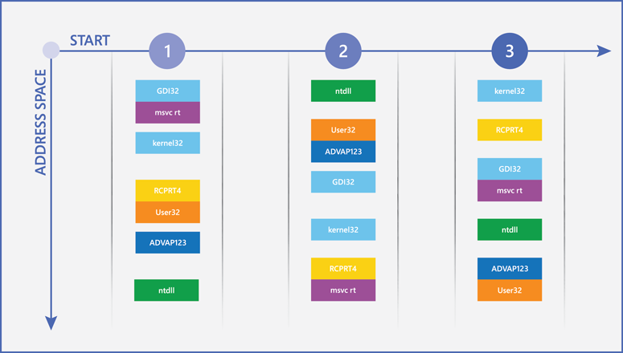
Address Space Layout Randomization (ASLR)
How ASLR works by showing how the locations of different critical Windows components can change in memory between restarts.

Slide 90
Address Space Layout Randomization (ASLR)
ASLR with Windows 10 :
applies ASLR holistically across the system and increases the level of entropy many times compared with previous versions of Windows to combat sophisticated attacks such as heap spraying.
64-bit system and application processes can take advantage of a vastly increased memory space, which makes it even more difficult for malware to predict where Windows 10 stores vital data.
When used on systems that have TPMs, ASLR memory randomization will be increasingly unique across devices, which makes it even more difficult for a successful exploit that works on one system to work reliably on another.

Slide 91
Key concepts: DEP

Slide 92
Data Execution Prevention (DEP)
System-level memory protection feature available in Windows operating systems.
DEP enables the operating system to mark one or more pages of memory as non-executable, which prevents code from being run from that region of memory, to help prevent exploitation of buffer overruns.
DEP helps prevent code from being run from data pages such as the default heap, stacks, and memory pools. Although some applications have compatibility problems with DEP, the vast majority of applications do not.

Slide 93
Data Execution Prevention (DEP)
Malware depends on its ability to insert a malicious payload into memory with the hope that it will be executed later.
Wouldn’t it be great if you could prevent malware from running if it wrote to an area that has been allocated solely for the storage of information?
Data Execution Prevention (DEP) does exactly that, by substantially reducing the range of memory that malicious code can use for its benefit.
DEP uses the No eXecute bit on modern CPUs to mark blocks of memory as read-only so that those blocks can’t be used to execute malicious code that may be inserted by means of a vulnerability exploit.

Slide 94
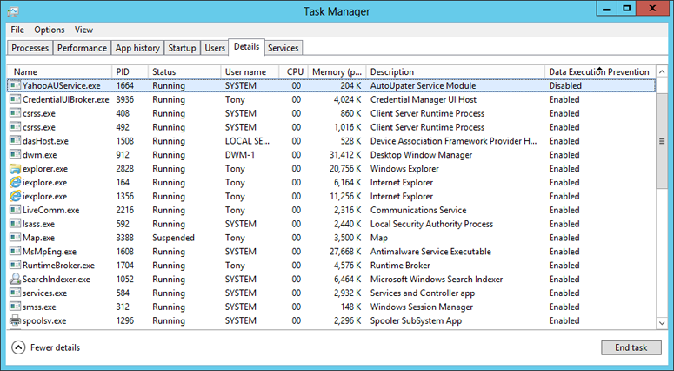
Data Execution Prevention (DEP)
Using Task Manager to identify process with or without DEP enable

Slide 95
Key concepts: Authenticode Code Signing

Slide 96
Code Signing - Authenticode
Use of Authenticode to sign software programs:
To prove its Integrity
To develop its Reputation
Digitally signing application code helps to ensure that it cannot be tampered.
Microsoft helpfully publishes the Windows Authenticode Portable Executable Signature Format (and the less relevant Microsoft PE and COFF Specification) document, which outlines in great detail how Authenticode works.
Notes:
https://blogs.msdn.microsoft.com/ieinternals/2014/09/04/caveats-for-authenticode-code-signing/

Slide 97
Authenticode
Authenticode implementation in Windows Authentication Portable (PE) signature format
Notes:
http://download.microsoft.com/download/9/c/5/9c5b2167-8017-4bae-9fde-d599bac8184a/Authenticode_PE.docx

Slide 98
Code Signing - Authenticode
A digital signature is only as strong as the hash algorithm to which the signature was applied.
If a hash algorithm is broken, signed hashes could be repurposed by bad guys.
Notes:
https://blogs.msdn.microsoft.com/ieinternals/2014/09/04/caveats-for-authenticode-code-signing/

Slide 99
Authenticode - Hashing attacks
Collision attack: relying on two different programs (one good, and one evil) that hash to the same value.
In Authenticode, this would only be interesting if he could convince someone else to sign the “good” program
That signature could then apply to the “evil” variant.
This attack is possible against MD5 today.

Slide 100
Authenticode - Hashing attacks
In a second-preimage attack: attacker takes anyone else’s insecurely-signed legitimate program as input and generates a new evil program that hashes to the same value as the legitimate file.
Attacker can then copy the signature to his file and it will appear that the evil file was signed by the good guy.

Slide 101
Authenticode best practices
Do not use MD5 or SHA1
Prefer instead SHA256

Slide 102
Key concepts: SmartScreen

Slide 103
SmartScreen
SmartScreen Filter helps you identify reported phishing and malware websites and also helps you make informed decisions about downloads.
As you browse the web, it analyzes pages and determines if they might be suspicious.
SmartScreen checks the sites you visit against a dynamic list of reported phishing sites and malicious software sites. See URL reputation checks
SmartScreen checks files that you download from the web against a list of reported malicious software sites and programs known to be unsafe. See Application Reputation protection
Notes:
https://blogs.windows.com/msedgedev/2015/12/16/smartscreen-drive-by-improvements/

Slide 104
SmartScreen
SmartScreen has expanded its scope from phishing attacks and socially engineered malware to also include warnings for deceptive advertisements and support scam sites.
With the latest Windows 10 updates, SmartScreen extended to include protection from drive-by attacks in Microsoft Edge and Internet Explorer 11.
Notes:
https://blogs.windows.com/msedgedev/2015/12/16/smartscreen-drive-by-improvements/

Slide 105
SmartScreen and drive-by attacks
Drive-by attacks are malicious web attacks that tend to start on trusted websites, targeting security vulnerabilities in commonly used software.
They often don’t require any user interaction – so there’s nothing to click, nothing to download – and infection is usually invisible.
Make use of services known as exploit kits (EKs) to scale effectively.
Vulnerabilities can be either newly discovered ones – also known as 0-days
Notes:
https://blogs.windows.com/msedgedev/2015/12/16/smartscreen-drive-by-improvements/

Slide 106
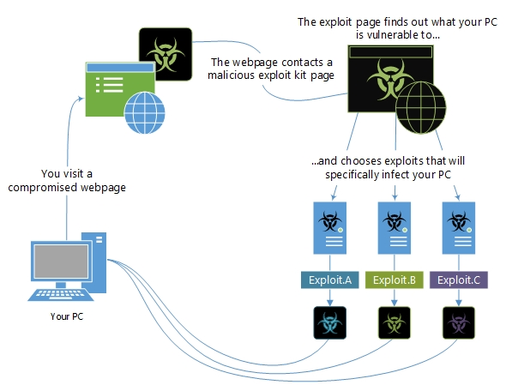
SmartScreen and Exploit kits
Use a variety of exploits to attack your PC
Prevalent exploit kits may include
Angler / Axpergle
Neutrino
Nucleare
kits can use exploits targeting a variety of software
Notes:
https://www.microsoft.com/en-us/wdsi/threats/exploit-malware

Slide 107
Key concepts: Export Address Table Access Filtering

Slide 108
Export Address Table Access Filtering (EAF) - overview
Filters access to the Export Address Table
The Export Address Table (EAT) publishes a modules exported functions
EAF mitigation protects the EAT of important modules ntdll.dll, kernel32.dll, and kernelbase.dll
Uses debug registers to breakpoint and control access to the EAT
Can be incompatible with certain software, including: Debuggers, Anti-Debugging techniques, DRM techniques, or other software protection mechanisms.
Notes:
https://zerosum0x0.blogspot.com/2017/06/proposed-eafemet-bypass-for-reflective.html

Slide 109
EAF+ Overview
Extension of EAF that can be used independently or in conjunction with EAF
Provides the following actions:
Detects if the stack register is out of the allowed boundaries
Detects mismatch of stack and frame pointer registers
Detects memory read access to export table pointers of kernel32.dll, ntdll.dll, and kernelbase.dll originated from specific modules
Detects memory read access to the MZ/PE header of specific modules (Based on a specific set of configurable modules)
Notes:
https://zerosum0x0.blogspot.com/2017/06/proposed-eafemet-bypass-for-reflective.html

Slide 110
Export Address Table Access Filtering (EAF)
EAF sets hardware breakpoints that check for legitimate access when the function exports of KERNEL32.DLL and NTDLL.DLL are read.
It does this by checking if the offending caller code is part of a legitimately loaded module (which reflective DLL injection is not).
Windows 10 will also be adding the brand new Import Address Table Access Filtering (IAF).
Notes:
https://zerosum0x0.blogspot.com/2017/06/proposed-eafemet-bypass-for-reflective.html

Slide 111
Key concepts: SEHOP

Slide 112
Structured Exception Handling Schema

Slide 113
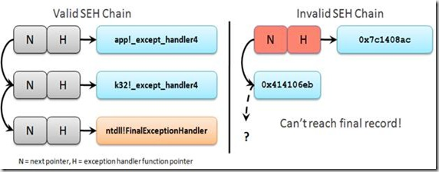
SEHOP Overview
SEHOP validates integrity of exception chain when exceptions fire
Notes:
https://zerosum0x0.blogspot.com/2017/06/proposed-eafemet-bypass-for-reflective.html

Slide 114
Key concepts: Control Flow Guard

Slide 115
Control Flow Guard (CFG) - Overview
CFG is a highly-optimized platform security feature that was created to combat memory corruption vulnerabilities
By placing tight restrictions on where an application can execute code from, it makes it much harder for exploits to execute arbitrary code through vulnerabilities such as buffer overflows
CFG extends previous exploit mitigation technologies such as /GS, DEP, and ASLR
Notes:
https://zerosum0x0.blogspot.com/2017/06/proposed-eafemet-bypass-for-reflective.html

Slide 116
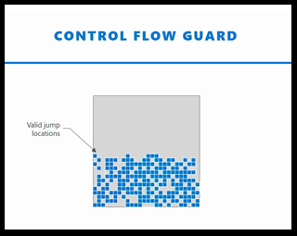
Control Flow Guard (CFG) – How it works
In simplistic terms, at compile time there is a bit map table built of all the legitimate target locations the code can jump too
During the execution of the application, whenever there is a call to jump to a new target location, CFG verifies that the new location was in the bit map table of valid jump locations
If the requested jump location is not listed in the “Valid Jump Locations”, Windows terminates the process thereby preventing the malware from executing
Notes:
https://zerosum0x0.blogspot.com/2017/06/proposed-eafemet-bypass-for-reflective.html

Slide 117
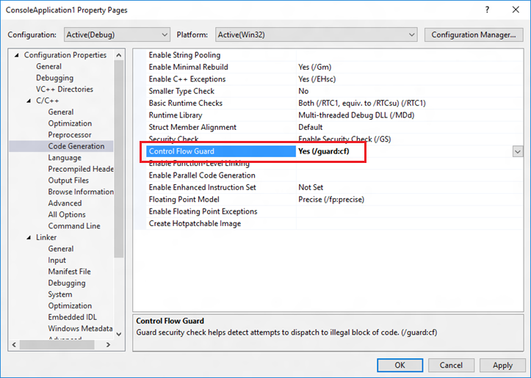
Control Flow Guard (CFG) – How enable it
In most cases, there is no need to change source code
Add an option to Visual Studio 2015 project, and the compiler and linker will enable CFG
Navigate to Project | Properties | Configuration Properties | C/C++ | Code Generation and choose Yes (/guard:cf) for Control Flow Guard
Notes:
https://zerosum0x0.blogspot.com/2017/06/proposed-eafemet-bypass-for-reflective.html

Slide 118
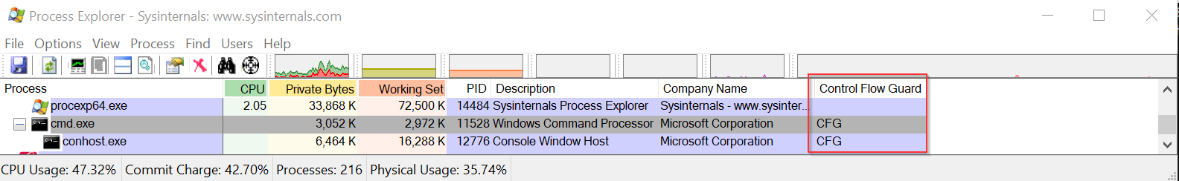
Control Flow Guard (CFG) – How checking if enable
If you want to know which applications have enabled CFG on your system (Windows 10/Server 2016), you can start up SysInternals ProcessExplorer (v16.20)
By default, the column “Control Flow Guard” isn’t displayed so it will have to be added
View / Select Columns / Process Image (tab) – Select “Control Flow Guard”
Notes:
https://zerosum0x0.blogspot.com/2017/06/proposed-eafemet-bypass-for-reflective.html

